Slide 1
Mission 6 Remix
Create your own project from Mission 6

Slide 2

Warm-up
In your Mission 6 Remix Log, answer the pre-mission preparation questions:
How would you describe Mission 6 to your friends?
What was challenging about Mission 6?

Slide 3

Time for a project remix!
A remix can be:
A new program created by adding new code to a program you already created
You can combine parts of two or more programs in a remix
Use a similar idea in a different way

Slide 4
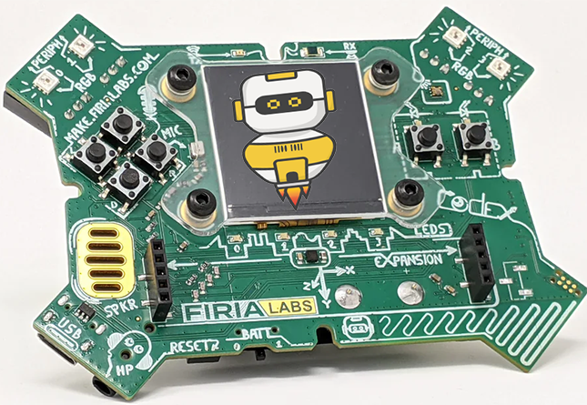
Project Remix
Creating a remix will let you:
Improve your skills and practice the concepts from the mission
Be creative
Remember code from earlier programs and missions
Work with other students
Design an original program and write the code all on your own

Slide 5
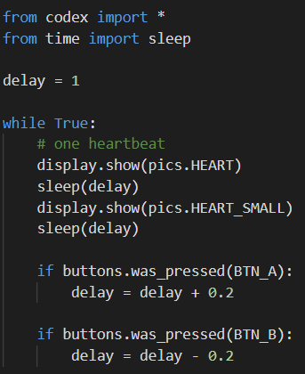
Step #1
Review the mission
Open your project from
Mission 6
  What does the program do?
  What skills were used or concepts learned?
DO THIS:
Fill out the information in the Mission 6 Remix Log for Step 1

Slide 6
Step #2
Brainstorm ideas
Read through remix suggestions from your teacher
Eight suggestions are on the next 4 slides. You can use any of these ideas or come up with your own.

Slide 7
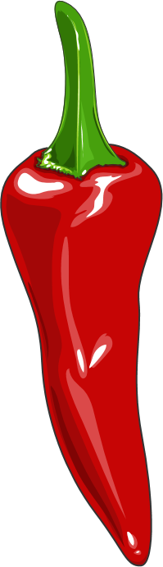
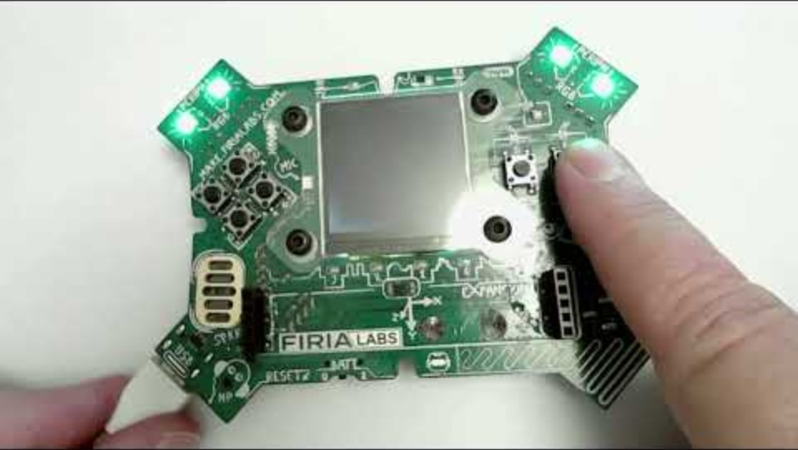
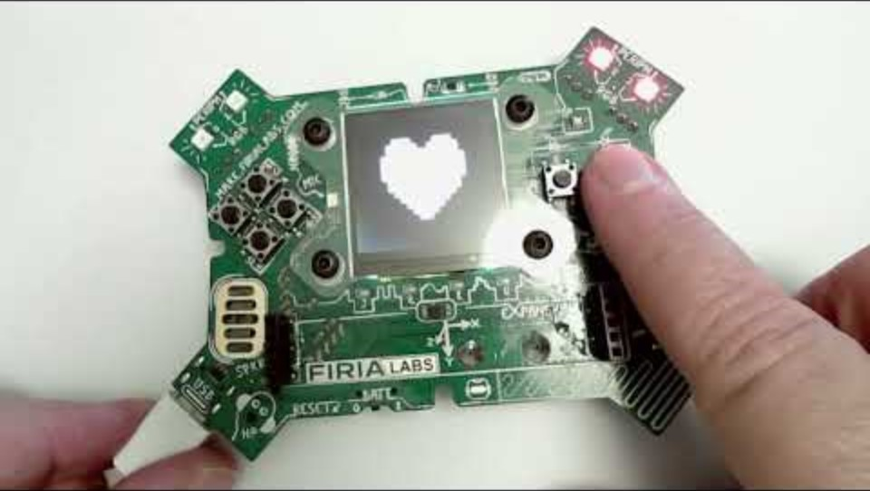
Step #2 Remix Ideas
Mild
Make one or more pixels flash on and off instead of an image on the screen.
Mild
Add flashing pixels to the heartbeat. You have one, two or all of the pixels flashing during the heartbeat.

Slide 8
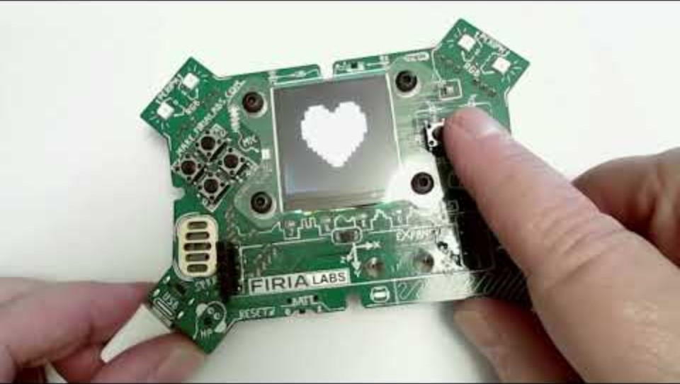
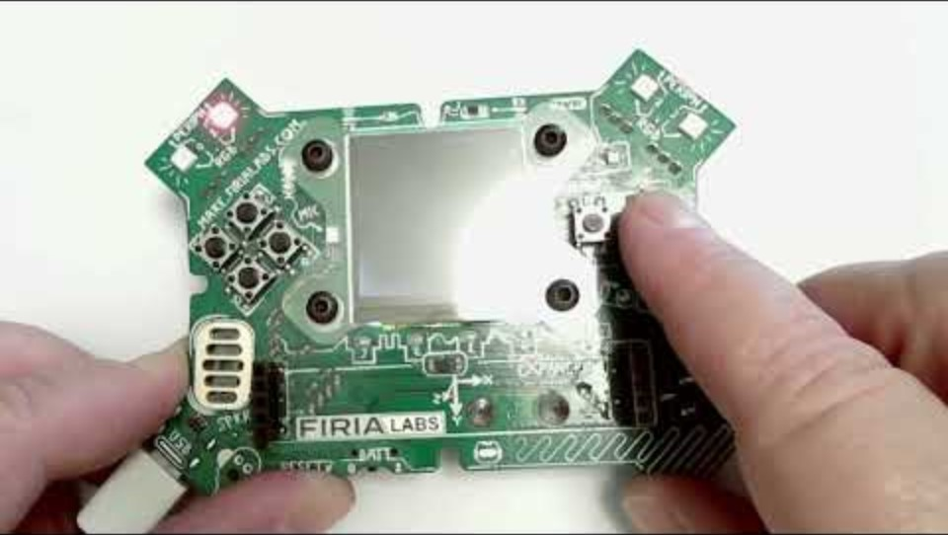
Step #2 Remix Ideas
Medium
Add another if statement for a different button press that will break out of the loop to stop the program.
Medium
Change the flashing image to pixels that roll, turning on one at a time. One sequence will be pixel 0, then pixel 1, then pixel 2, and then pixel 3. Repeat the sequence in a loop, with the option to speed up or slow down.

Slide 9
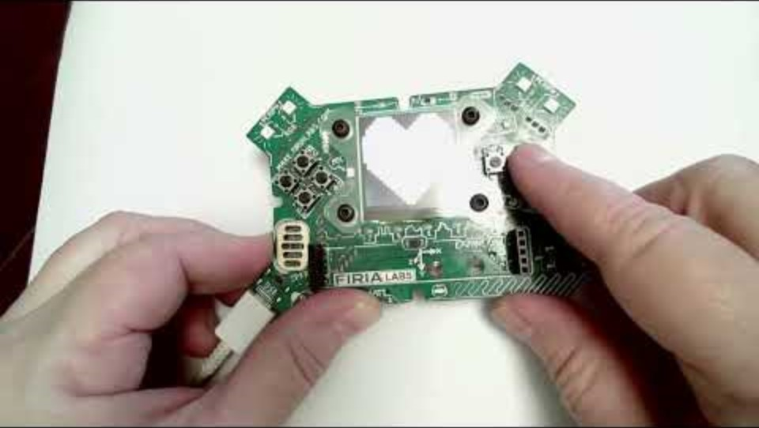
Step #2
Medium
Add two pitch sounds to the heartbeat, one for each image. Use the delay variable in the pitch statement instead of a sleep statement
Example:
audio.pitch(440, delay)
Spicy
Add code that will prevent the runtime error. Remember: the error happens when delay is below 0. How can you make sure this doesn’t happen?
You can include any of the options in the spicy remix.

Slide 10
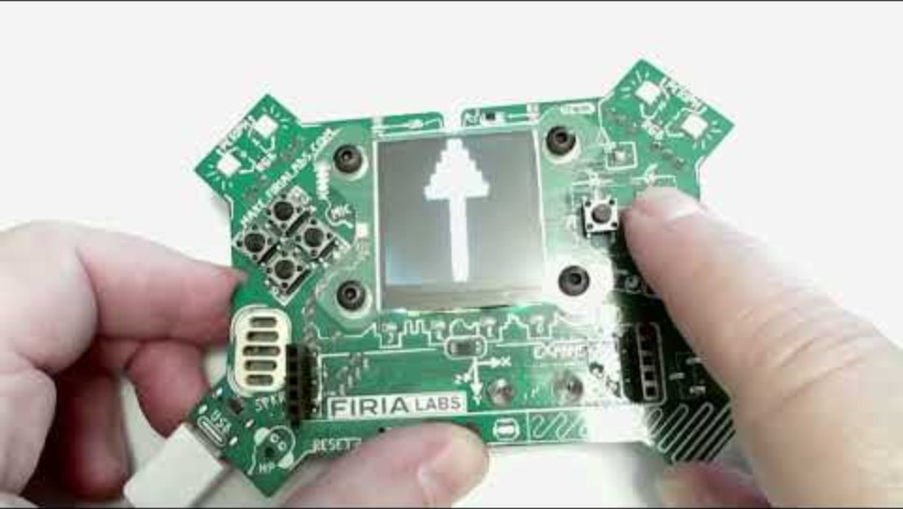
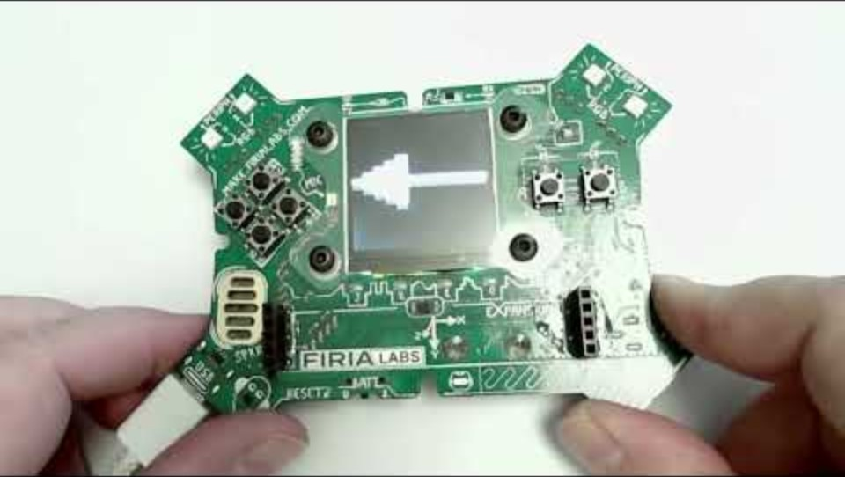
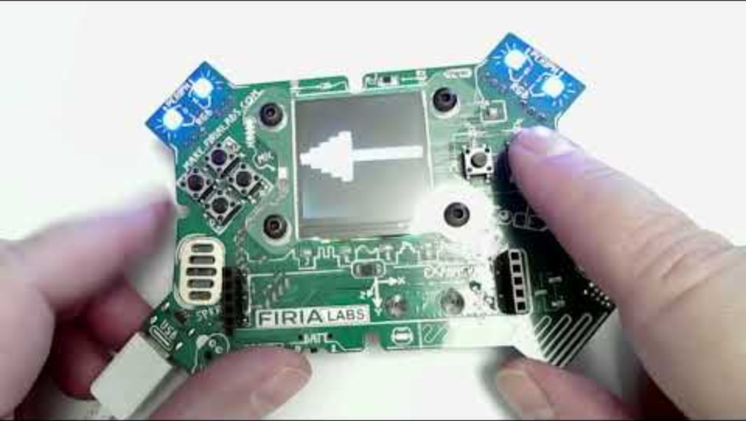
Step #2
Extra Spicy
Add a menu that explains what each button press will do, and another break to hold the menu until they want to start. Also, include an ending message. If you include flashing pixels, add another variable for the color.
Spicy
Change the flashing image to a left (west) or right (east) arrow. Use different button presses to change from one image to the other.

Slide 11
Step #2
Brainstorm ideas
Read through remix suggestions from your teacher (previous slides)
Use your creativity to come up with your own idea for a project
Decide with your partner what project you will do
DO THIS:
Fill out the information in the Mission 6 Remix Log for Step #2

Slide 12
Step #3
Make a plan
What variables will you need? What will you use them for?
What images will you display?
What pixels will you turn on/off?
What buttons will you program, and what will each button do?
DO THIS:
Fill out the information in the Mission 6 Remix Log for Step #3

Slide 13

Step #4
Code your project
IMPORTANT: Go to the sandbox to code the remix project
  Above toolbox in the lower left corner
Start with a new file and give it a descriptive name (Remix6)
You can leave any program open, including Heart2, and use it as a guide
Import your modules
Define your variables
Write your code, testing frequently

Slide 14
Step #4
Stop and test frequently!
Don’t try to write all the code at one time
Mistakes happen, so find them early
Type just a few lines of code and then run the program
If there is an error, fix it before continuing
Use the debugger and your other programs for help

Slide 15
Step #5
Documentation!
Make sure your code is readable by adding blank lines
Add comments to sections of your code that explain what they do

Slide 16
Step #5
Get feedback
Show your code to other students
What do they think? Have them fill out the feedback form on your Mission 6 Remix Log
Give yourself some feedback Is there something you want to change or improve or add? Fill out the feedback form on your Mission 6 Remix Log
Modify your code to make your project even better

Slide 17

And now you have your own remix!
Congratulations!
By completing this remix you have:
learned more about programming
practiced the skills and concepts from the missions
been thinking! And problem solving and much more!

Slide 18
Mission Reflection
Wow! Great job!
Share your project with your friends!
Complete your Mission 6 Remix Log
Don’t forget to clear your CodeX by running your Clear program

